Slide 1
Quarterly Update on the National Inventory Collaborative
March 15, 2018

Slide 2
Today’s Schedule
12:00 Introduction & Coordination Workgroup
12:10 EGUs
12:17 Non-EGU Point
12:24 Oil and gas sources (point and nonpoint)
12:31 Nonpoint
12:38 Onroad
12:45 Nonroad
12:53 Rail
1:00 Commercial Marine Vessels (CMV)
1:07 Fires
1:14 Biogenics
1:21 Wrap up + Q&A
1:30 Sign Off

Slide 3
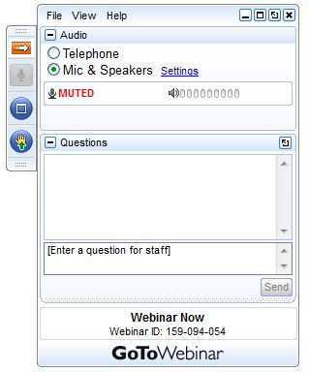
Webinar Ground Rules: Questions?
Each workgroup will give a 7 minute update introducing their group and their plans for the coming months.
All call participants will remain on mute during the webinar.
Type your questions into the question box on the webinar client.
We will try to answer questions at the end of the webinar.
We will create a Q&A document following the webinar and post with the meeting notes on the Collaborative Wiki: http://views.cira.colostate.edu/wiki/wiki/9169

Slide 4
Origin of the Platform Collaborative
A new multi-purpose emissions modeling platform (EMP) based on the 2014 National Emissions Inventory version 2 (2014NEIv2) is needed
  State Implementation Plans, federal analyses
Regional organizations and states asked to be more involved in the development of national EMPs
  Need for broader input into the methods used, especially for “projections” of emissions to future years
For the first time, EPA, states, and MJOs are engaging in collaborative EMP development
  The 2016 base year was selected via a collaborative process
  Process and timing are evolving
  Participation in the EMP collaborative is voluntary

Slide 5
Organizational Structure
Coordination co-leads: Zac Adelman (LADCO) and Alison Eyth (EPA OAQPS)
  Developed process and communication structures, facilitate discussions, help resolve issues, documentation requirements, coordinate distribution of data to stakeholders
Coordination committee: regional, state, EPA leaders
  Define processes, resolve issues, co-lead workgroups
  Includes overall and WG co-leads plus MJO directors
Sector-specific Workgroups: one regional/state staff and one EPA staff (where possible)
  Focus on preparing emissions estimates for 2016 and future years, plus improve how the emissions sectors are modeled
  Include participants from EPA/states/locals/regions

Slide 6
2016 EMP Schedule
Several versions of 2016 platform will be developed
  Alpha: preliminary version with 2014 NEIv2 scaled for most and 2016 emissions for some sectors for initial testing of 2016 model runs (March, 2018)
  Beta: improved and/or new version of actual 2016 emissions for most sectors and preliminary projected emissions to 2023 and 2028 (Summer-Fall, 2018)
    Exact timing of beta 2016 and projections is uncertain
  V1.0: fully updated 2016 emissions and complete projected emissions for 2023 and 2028
  (Winter, 2019)
Schedule overlaps with 2017 NEI Development
  Prioritize the 2017 NEI over the 2016 platform, as needed
  Any missing data for 2016 will be filled in based on 2014 NEI data and nationally consistent methods

Slide 7
Alpha Platform Release
EPA performed a coordinated release of 2014, 2015, and 2016 emission inputs developed by EPA for alpha
  Includes scripts and input data
  EPA will not have a full set of AQM-ready inputs or outputs for these cases, but will provide 2 weeks of sample outputs
  Data for emissions platforms on EPA FTP site
  ftp://newftp.epa.gov/Air/emismod/2014/v2/
  ftp://newftp.epa.gov/Air/emismod/2015/alpha/
  ftp://newftp.epa.gov/Air/emismod/2016/alpha/
  Preparing consolidated release for modeling groups
2016 meteorology sent to LADCO for distribution
  Evaluation to be provided by EPA

Slide 8
Alpha Platform Components
Nonpoint sectors mostly use 2014NEIv2
  https://www.epa.gov/air-emissions-inventories/2014-national-emissions-inventory-nei-data
  2014NEIv2 documentation is coming soon
Onroad mobile source emissions based on 2014NEIv2 inputs with MOVES runs for 2015 and 2016
Nonroad mobile source emissions based on inputs for 2014NEIv2 with MOVES/NONROAD runs for 2015 and 2016
Wild, prescribed, and agricultural fire emissions derived from nationally available input data sets for 2015 and 2016
Biogenic emissions for 2015 and 2016 (developed using BEIS)
2015 point sources available, draft 2016 point sources coming soon (state submissions were due January 2018)
Electric generating unit (EGU) emissions using year-specific Continuous Emissions Monitoring Systems (CEMS) data
Latest available emissions modeling data for temporal allocation, spatial allocation, and speciation

Slide 9
Workgroup Overview (1)
Workgroup | Co-leads | Members | Beta plans
Biogenics | Jeff Vukovich (OAQPS), Doug Boyer (TCEQ) | 10 | Run MEGAN v3, compare to BEIS
Fires | Jeff Vukovich, Tom Moore (WESTAR) | 30+ | Evaluate 2016 draft; update if resources, Projections
Oil and gas (point+nonpoint) | Tom Moore (WESTAR), Jeff Vukovich | 30+ | Evaluate alpha, leverage state/EPA resources, Projections
Nonpoint (dust, RWC, ag, other) | Caroline Farkas (OAQPS), Chris Swab (OR) | 30+ | Evaluate alpha subsectors, Projections
Non-EGU point (includes aircraft) | Caroline Farkas, Tammy Manning (NC) | 30+ | Split from EGUs, review alpha, projections
EGUs | Julie McDill (MARAMA), Serpil Kayin (OAP), Alison Eyth (base yr) | 30+ | Finalize 2016, include both ERTAC and IPM projections

Slide 10
Workgroup Overview (2)
Workgroup | Co-leads | Members | Beta plans
Onroad | Julie McDill (MARAMA), Alison Eyth (OAQPS) | 30+ | Incorporate state activity: 2016, future
Marine | Mark Janssen (LADCO), Michael Aldridge (OTAQ) | 20+ | Use AIS geolocation data, but not until v1.0
Rail | Mark Janssen (LADCO), EPA OAQPS EIAG | 30+ | Incorporate 2016 activity
Nonroad | Sarah Roberts (OTAQ), Joe Jakuta (OTC) | 30+ | MOVES 2014b with nonroad activity and EF/fuel updates
Meteorology | Chris Misenis (OAQPS) [not currently meeting] | 15 | EPA to release evaluation
International | Alison Eyth (email only) [involve regional staff] | 10 | Update Mexico; AK shipping?

Slide 11
Upcoming NEI Training
Due to overwhelming demand for training at the Baltimore Emission Inventory Conference, EPA OAQPS is hosting training in RTP May 15-17, 2018
  Courses offered: point, MOVES, oil and gas, ammonia, emissions modeling and projections, toxics release inventory (TRI), SPECIATE, inventory guidance
  Nonpoint will not be offered
Open to state/local/tribal agencies and contractors responsible for preparing inventories
  2017 inventories are due to EPA by the end of 2018
Register at https://www.epa.gov/air-emissions-inventories/air-emissions-inventory-training

Slide 12
Collaborative Workgroup Reports
12:10 EGUs
12:17 Non-EGU Point
12:24 Oil and gas sources (point and nonpoint)
12:31 Nonpoint
12:38 Onroad
12:45 Nonroad
12:53 Rail
1:00 Commercial Marine Vessels (CMV)
1:07 Fires
1:14 Biogenics
1:21 Wrap up
1:30 Conclude

Slide 13
2016 Point Inventory
2016 point source data state submissions were due 1/15/2018
EPA NEI team emailed emissions QA comparisons of 2016 data to 2014v2, 2016 TRI, and CAMD data
2016 draft point inventory (both EGUs and non-EGUs) will be available in EIS and flat file for modeling later this month
S/L/Ts may edit their data in EIS as needed or contact EPA to edit EPA-loaded data
Goal: to have a 2016 point inventory that includes 2016-specific data, where available, and is appropriately split into EGUs (both those with and without CEMS) and non-EGUs for ERTAC and IPM

Slide 14
Electricity Generating Units (EGUs)
Co-leads: Julie McDill (MARAMA), Serpil Kayin (EPA),
Alison Eyth (EPA)
Schedule: Calls on 4th Thursday at 2:00pm Eastern
  Kickoff January 25, next call March 22
Members:
  Adel Alsharafi (MO), Leon Ashford (OK), Marie Barnes (NY),
  Deb Basnight (GA), Carla Bedenbaugh (SC), Chris Beekman (OH), Molly Birnbaum (AK), Randy Bordner (PA), Hassan Bouchareb (MN), George Bowker (EPA), Emily Bull (MD), Yu-Lien Chu (WI),
  Rory Davis (IL), Barry Exum (TX), Alison Eyth (EPA), Caroline Farkas (EPA), Paula Hemmer (NC), Craig Henrikson (MT), Roslyn Higgin (NM), Anne Jackson (MN), Wendy Jacobs (CT), Mark Jones (NM), Serpil Kayin (EPA), Byeong-Uk Kim (GA), Steve Lachance (MI), Adam Lewis (NJ), Jon Loftus (WI), Doris McLeod (VA),
  Jeremy Neustifter (CO), Ona Papageorgiou (NY), Leslie Poff (KY), Andy Russo (IL), Ken Santlal (MA), Tom Shanley (MI), Eric Svingen (EPA), Curtis Taipale (CO), Sylvia Vanderspek (CA), John Welch (IN), Anna Wood (AL), Ming Xie (NC)

Slide 15
EGU Workgroup: Approach
Crosswalk & Redistribution of point sources into EGU and non-EGU sectors for ERTAC and IPM modeling
  CEMS vs NEI will be compared to 2016 ERTAC inputs to confirm existing matches and match additional sources
Temporal allocation approach for base and future years needs to be confirmed for units with and without CEMS data
Projection
  ERTAC EGU 2016 process
    2016 complete
    Projection to 2023 & 2028 underway
    Expect to use AEO 2018 High Oil and Gas scenario for many regions
    State review of ERTAC EGU 2016/2023/2028 Expected summer 2018
    2023/2028 projection targeted for Fall 2018
  Both EPA and ERTAC projections should be available (timing TBD)

Slide 16
EGU Workgroup: Inventory Versions
  Alpha – EPA CEM data
  Beta – ERTAC EGU 2016/2023/2028 without state updates
  V1 – ERTAC EGU 2016/2023/2028 with state updates
    Other projection years are typically prepared for ERTAC EGU

Slide 17
Non-EGU Point Workgroup
Co-leads: Tammy Manning (NC), Caroline Farkas (EPA)
Schedule: Calls on 3rd Tuesday at 2:00pm Eastern
Members:
  Ken Santlal (MA), Wendy Jacobs (CT), Steve Potter (CT), Ken Newkirk (NY), Laura Stevens (NY), John Barnes (NY), Adam Lewis (NJ), Hannah Ashenafi (MD), Kotur Narasimhan (VA), Thomas Foster (VA), Bryan Oshinski (PA), Anna Wood (AL), Brian Sullins (AL), Ben Cordes (KY), Chad Wilbanks (SC), Deb Basnight (GA), Richard McDonald (GA), James Smith (TN), Jay Koch (IN), Jon Loftus (WI), Mike Maleski (OH), Ron Thomas (TX), Doug Boyer (TX), Roslyn Higgin (NM), Lynn Deahl (KS), Craig Henrikson (MT), Scott Hanks (UT), Peter Verschoor (UT), Sylvia Vanderspek (CA), Stephanie Huber (CA), Vanessa Crandell-Beck (AK), Molly Birnbaum (AK), Ron Ryan (EPA), Brian Keaveny (EPA), Eric Svingen (EPA), Jenny Liljegren (EPA), Michael Leslie (EPA), Joseph Jakuta (OTC), Tom Moore (WESTAR)

Slide 18
Non-EGU Point Workgroup
Structure
  Possible subgroup – Aircraft
  Planning a call with those interested and Laurel Driver to discuss need, goals of subgroup
Participation to date
  1st call: ~17 S/L/Ts and EPA represented
  2nd call: ~11 S/L/Ts and EPA represented
First Steps
  2016 Point Review
    EIAG emailed S/L/Ts a set of emissions QA comparisons of submitted 2016 point source, NEI 2014v2, 2016 TRI, and CAMD data
    S/L/Ts can provide edits to their 2016 data by May 15

Slide 19
Non-EGU Point Workgroup
Timing: Final 2016 Non-EGU Point inventory targeted for end of June that will include 2014 point sources for any non-submitted/still operating facilities not in 2016
Projections: members are reviewing growth/control data from previous platform (2011 to 2023/2028) to prioritize subsectors

Slide 20
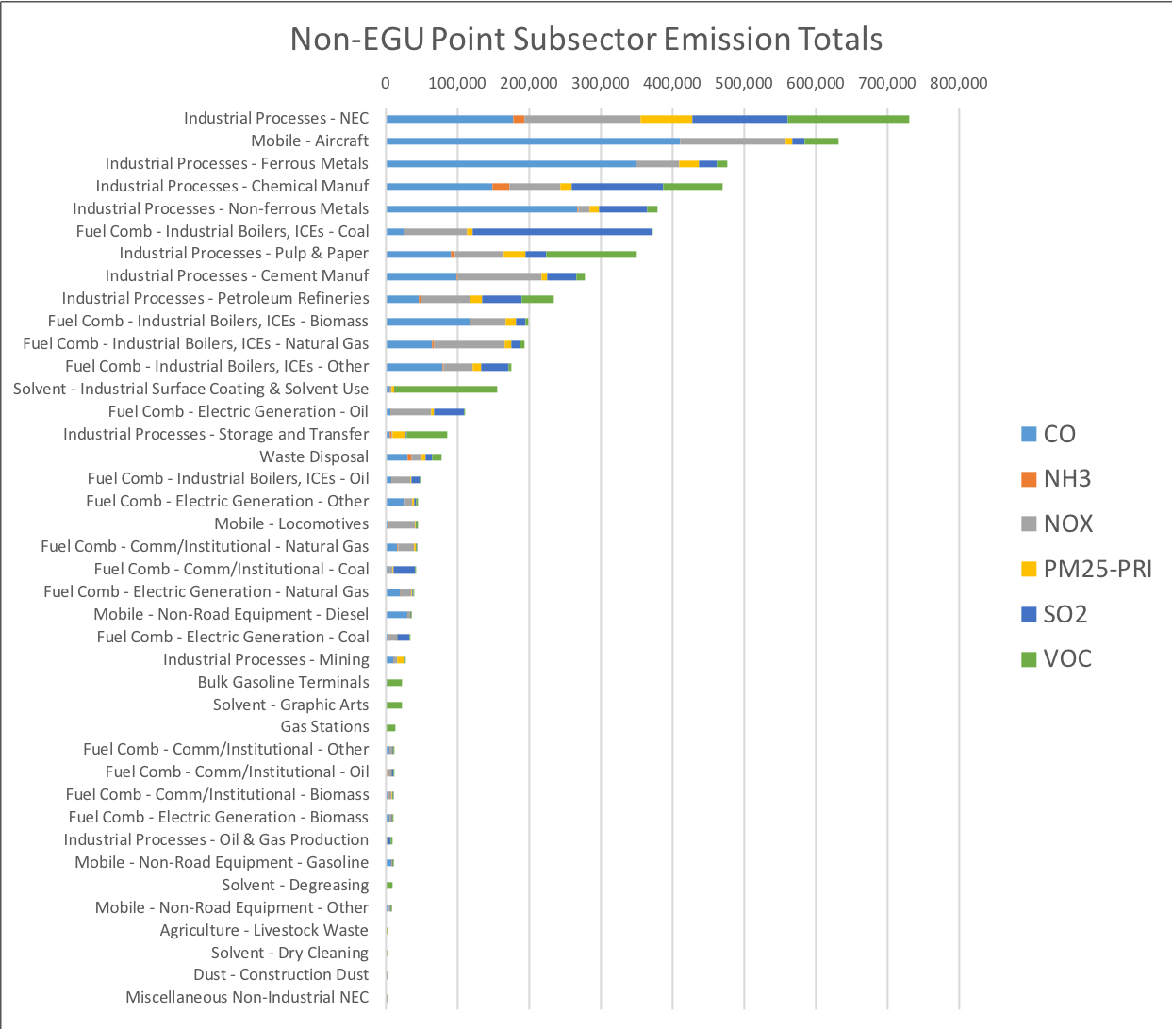

Slide 21
Oil and Gas Workgroup
Co-leads: Jeff Vukovich (EPA), Tom Moore (WESTAR and WRAP)
Schedule: Calls on 2nd Monday at 2:00pm Eastern
  Next call April 9th at 12:30pm Eastern
Members:
  States, locals, EPA regions, OAQPS, consultants
  TX, CA, WY, OH, AK, NY, MI, WV, NM, MT, OK, PA, CO, KS, EPA R8, OAQPS, Denver/NFR RAQC, WESTAR/WRAP, Ramboll
  Group comprised of subject matter experts from National O&G Emissions Committee

Slide 22
Oil and Gas Workgroup
Kickoff call was March 12th
  Intros: name, agency, daily job with respect to O&G issues
  Active and engaged group
  Questions & suggestions from workgroup charge and other docs reviewed
Additional review docs will be distributed

Slide 23
Oil and Gas Workgroup: First Steps
First need is to converge on final charge for the workgroup – draft reviewed on call
  https://drive.google.com/open?id=1gSPGuunaE5J5Xbm2Cj11C72j6bq4zwdUBsV9MMBpiKE
Second need is to facilitate alignment between 2016 EMP and 2017 NEI for O&G sources – doc reviewed
  2016EMP - 2017NEI alignment for oil and gas sources (draft dated Mar 7, 2018)
  OAQPS contractor support will be needed, associated timing TBD
Alpha Version = brief summary
  2014NEIv2 ftp://newftp.epa.gov/Air/emismod/2014/v2/2014fd/emissions/
  Optional projected 2016 ftp://newftp.epa.gov/Air/emismod/2016/alpha/2016fd/emissions

Slide 24
Oil and Gas Workgroup: Timing
March – Alpha version completed by EPA (from 2014NEIv2 based on EPA projection factors to scale to year 2016)
April/May - assessment of Alpha O&G EI and develop survey for “new 2016 baseline”, particularly equipment ages/types, operator practices, and fleet turnover effects of on-the-books regulations
June - release survey, identify projection approach(es)
August - begin analysis of results and begin updates to an “actual 2016” O&G EI
September - process and review 2016 Beta emissions, make initial emissions projections, and prepare documentation
Fall – Beta version of 2016 (changes from Alpha version plus initial projections to years 2023 and 2028)
Winter 2018-19 - review and further assess base and projection inventories, document changes as needed
March 2019 – 2016v1.0 with projections to 2023 and 2028

Slide 25
Nonpoint Workgroup
Co-leads: Chris Swab (OR), Caroline Farkas (EPA), Jennifer Snyder (EPA)
Schedule: Calls on 4th Monday at 2:00pm Eastern
Members:
  Ken Santlal (MA), Collin Smythe (VT), Jeff Merrell (VT), Judy Rand (NJ), Nicholle Worland (NJ), John Barnes (NY), Carlos Mancilla (NY), Alexandra Catena (DC), Shane Cone (DE), Walter Simms (MD), Mark Houser (PA), Thomas Foster (VA), Judy Hayes (AL), Sabrina Blakely (AL), Byeong-Uk Kim (GA), Richard McDonald (GA), Andy Bollman (NC), Stephen Lachance (MI), Tom Shanley (MI), Azra Kovacevic (MN), Laura Woods (OH), Erica Fetty-Davis (OH), Nishanthi Wijekoon (WI), Michael Ege (TX), Marnie Stein (IA), Lynn Deahl (KS), Stacy Allen (MO), Farah Mohammadesmaeili (AZ), Ryan Templeton (AZ), Sylvia Vanderspek (CA), Vanessa Crandell-Beck (AK), Brian Keaveny (EPA)
Participation to date:
  1st and 2nd calls: ~16 S/L/Ts and EPA represented

Slide 26
Nonpoint Workgroup: First Steps
A few members have begun to analyze emission total and growth/controls data to determine which subsectors might be able to be improved
Deciding on subsectors of interest
2014 -> 2016? Growth to 2016? Both?
Aiming to finalize beta version by June 1, 2018.

Slide 27
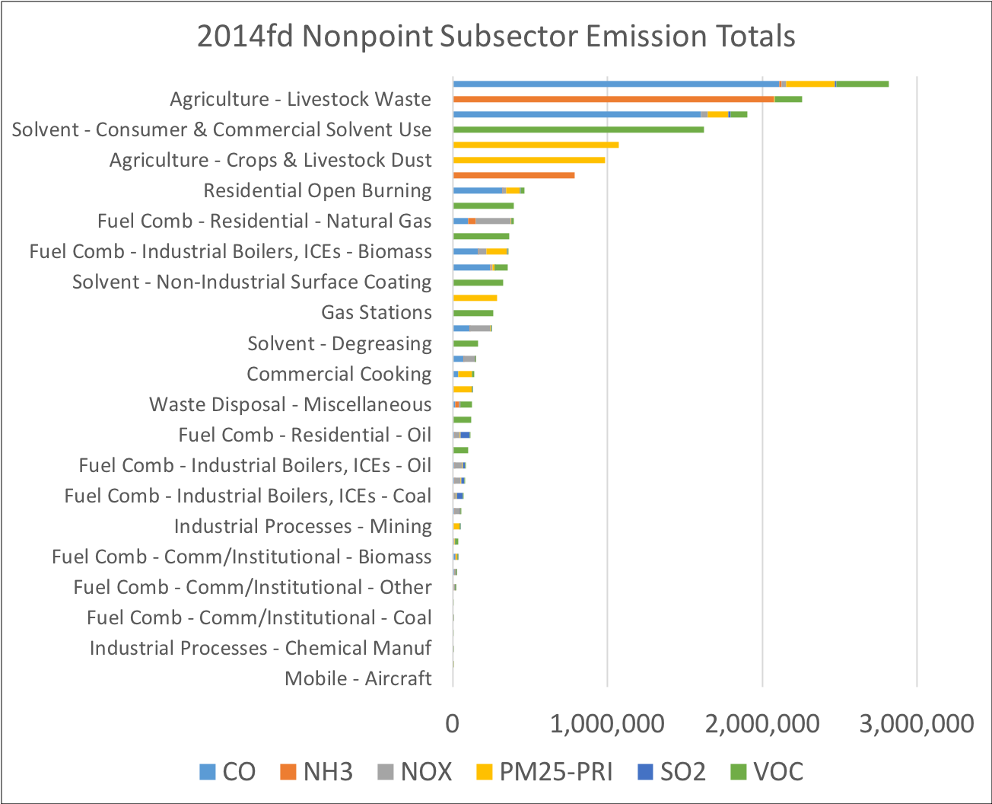

Slide 28
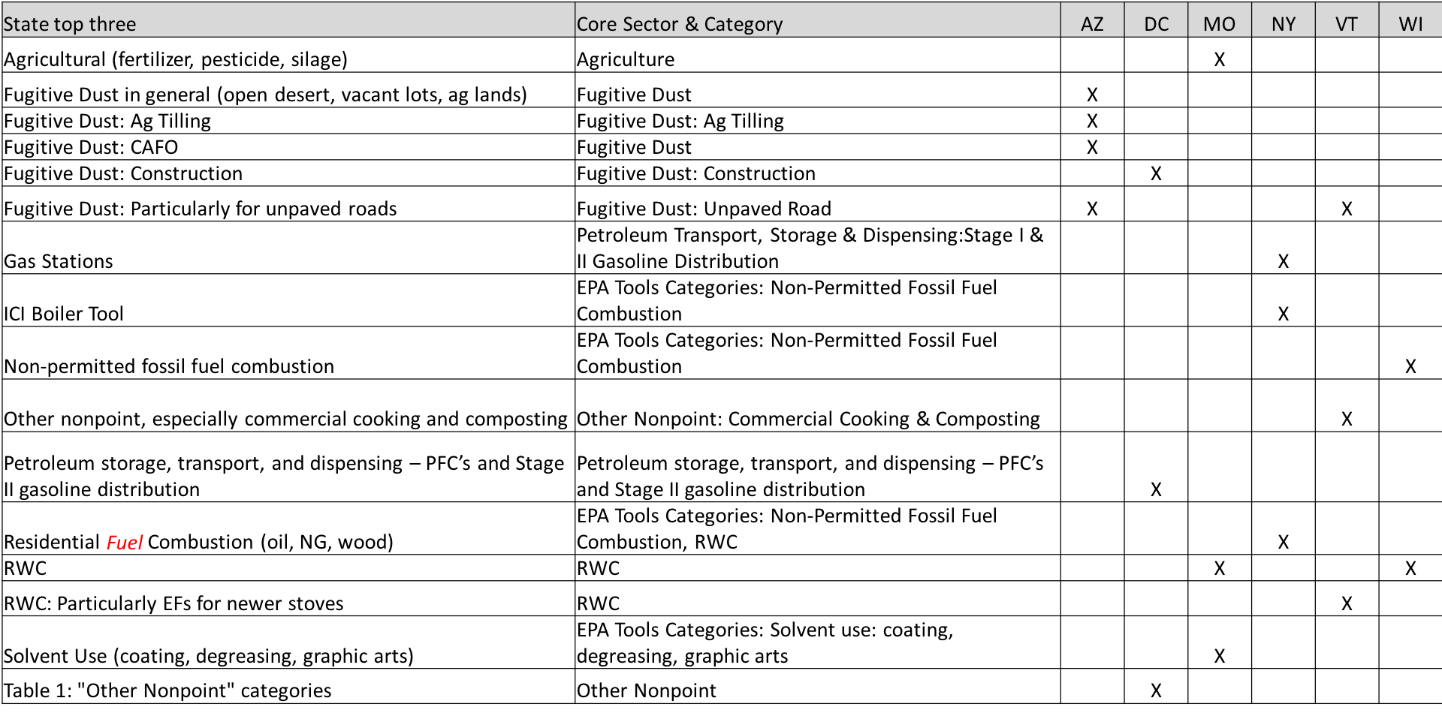
Nonpoint Workgroup: Member Survey

Slide 29
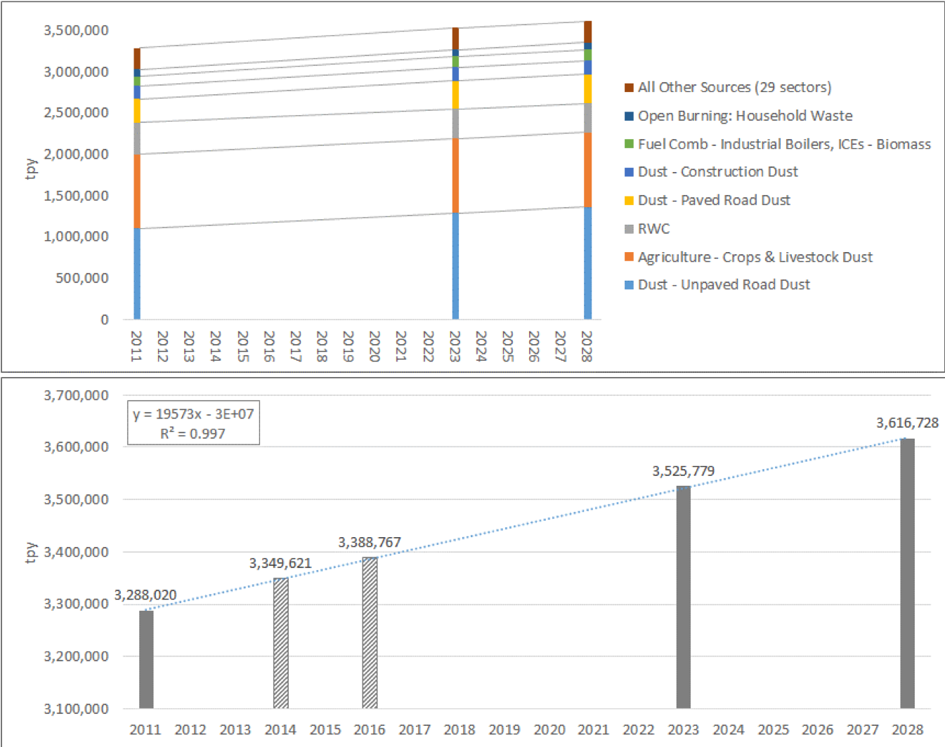
Nonpoint: Projections Approach
Start with review of NEI2011v3 projections
Continuity in sectors →
Sectors show linear growth
Continuity in total emissions →
Totals show linear growth also
Linear growth may be an option……
Example: “EL” platform total nonpoint PM_{2.5}

Slide 30
Onroad Mobile Workgroup
Co-leads: Julie McDill (MARAMA), Alison Eyth (EPA)
Schedule: Calls on 3rd Thursday at 2:00pm Eastern
  Kickoff December 20, 2 subsequent calls next call March 15
Members:
  Molly Birnbaum (AK), Brian Sullins (AL), Sylvia Vanderspek & Leo Ramirez (CA), Rebecca Simpson & Dale Wells (CO), Alexandra Catena (DC), Gil Grodzinsky (CA), Marc Bennett (MA), Marcia Ways (MD), Todd Pasley (NC), John Gorgol (NJ), Rob McDonough & Chris Rochester (NY), Mike Maleski (OH), Chris Trostle (PA), Susanne Cotty (Pima Co.), Carla Bedenbaugh (SC), Chris Kite (TX), Peter Verschoor & Rick McKeague (UT), Sonya Lewis-Cheatham (VA), Chris Bovee & Mike Friedlander (WI), Michelle Oakes (TN), Brian Timin (EPA OAQPS), Daniel Bizer-Cox & Dave Brzezinski (EPA OTAQ)
  Using MJO MOVES workgroup to explain approach and gather feedback

Slide 31
Onroad Mobile: Inventory Versions
  Alpha – 2016
    EPA projection from 2014 to 2016
    VMT projected from 2014v2 using FHWA Factors
    Preserved 2014v2 ratio of VMT/hr long-haul combination trucks hoteling Preserved 2014v2 ratio of VMT/vehicle population (VPOP)
  Beta - 2016/2023/2028
    Alpha defaults preserved for most states
    Replace some input data provided by 12 states
    representative county updates 5 to 10 states
    projection using AEO 2018 to 2023 and 2028
  V1 –2016/2023/2028
    Fold in CRC VIN decode updates for light duty age distribution

Slide 32
Onroad Mobile: 2016 Data
Overall: ftp://newftp.epa.gov/Air/emismod/2016/alpha/2016fd/
Emissions directory:
  2016 Activity data in FF10 format (VPOP, VMT, hoteling)
  ftp://newftp.epa.gov/Air/emismod/2016/alpha/2016fd/emissions/onroad/ includes onroad flat files (FF10) by county, SCC, poll for each state
Reports/onroad directory:
  Spreadsheet showing how EPA and state data were merged in the rep. county CDBs
  Growth factors used to derive 2016 activity from 2014v2
  Spreadsheet summarizing 2016 vs 2014 activity data
  Spreadsheets comparing 2014v1, 2014v2 and 2016 alpha onroad emissions at various resolutions
Maps directory:
  Maps of 2016 and 2014 county onroad emissions and differences between them for RPD, RPV, RPH, and total

Slide 33
Onroad Mobile: Expected Input Data
12 states, 3 datasets
Most CDB data is from EPA defaults
17 states plan to provide some state data for 5 specific categories
FF10 data format is challenging

Slide 34
Nonroad Mobile Workgroup
Co-leads: Joseph Jakuta (OTC), Sarah Roberts (EPA)
Schedule: Calls on 4th Thursday at 3:30pm Eastern
Members:
  Alexandra Catena (DC), Alison Eyth (EPA), Andy Bollman (NC), Brian Sullins (AL), Brian Timin (EPA), Brian Trowbridge (PA), Chris Bovee (WI), Chris Kite (TX), Chris Rochester (NY), Collin Smythe (VT), Dale Wells (CO), Gil Grodzinsky (GA, James Smith (TN), Jim Koronaides (NJ), Ken Santlal & Marc Bennett (MA), Mark Janssen (LADCO), Mike Maleski (OH), Peter Verschoor (UT), Rebecca Simpson (CO), Sonya Lewis-Cheatham (VA), Susanne Cotty (Pima Co.), Sylvia Vanderspek (CA), Tim Wallace (MD), Vanessa Crandell-Beck (AL)

Slide 35
Nonroad Mobile: Kickoff Meeting
February 8, 2018, 21 S/L/Ts and EPA attended
Reviewed Inventory Collaborative organizational structure, schedule, and resources
Reiterated that alpha nonroad inventory to be based on 2014NEIv2 inputs that are run for 2016
Established the need to identify data sets and sources that could be used to refine model inputs and provide sanity checks
Group consensus for future work group meetings to include presentations and discussions on local efforts to improve NONROAD inputs/emissions
Presented planned updates to EPA’s NONROAD model

Slide 36
Nonroad Mobile: MOVES2014b
EPA is planning to release MOVES204b – minor update to improve the nonroad capabilities of MOVES
MOVES2014b will include new nonroad engine population growth factors and will resolve a bug in the nonroad fuel supply. It will also update emissions for Tier 4 nonroad engines.
Updates are primarily database-driven, with only minor modifications to the model source code
This update will not impact inventories of onroad criteria pollutants and will not be considered a new model for SIP and transportation conformity purposes
Updates have been peer-reviewed and EPA is conducting integrated testing to quantify net emissions changes between MOVES2014a and MOVES2014b
Targeting a summer 2018 release, so that MOVES2014b can be used to build the beta and 2016v1 nonroad inventories and projections

Slide 37
Rail Workgroup
Co-leads: Mark Janssen (LADCO), Matt Harrel (IL EPA)
Schedule: Calls on 3rd Thursday at 11:00am Eastern
Members:
  57 Total: 34 state/local/regional, 8 EPA, 15 rail industry
  4 subgroups: Line Haul, Yards, Class 2/3, Commuter
  Only 4 members are participating in all subgroups

Slide 38
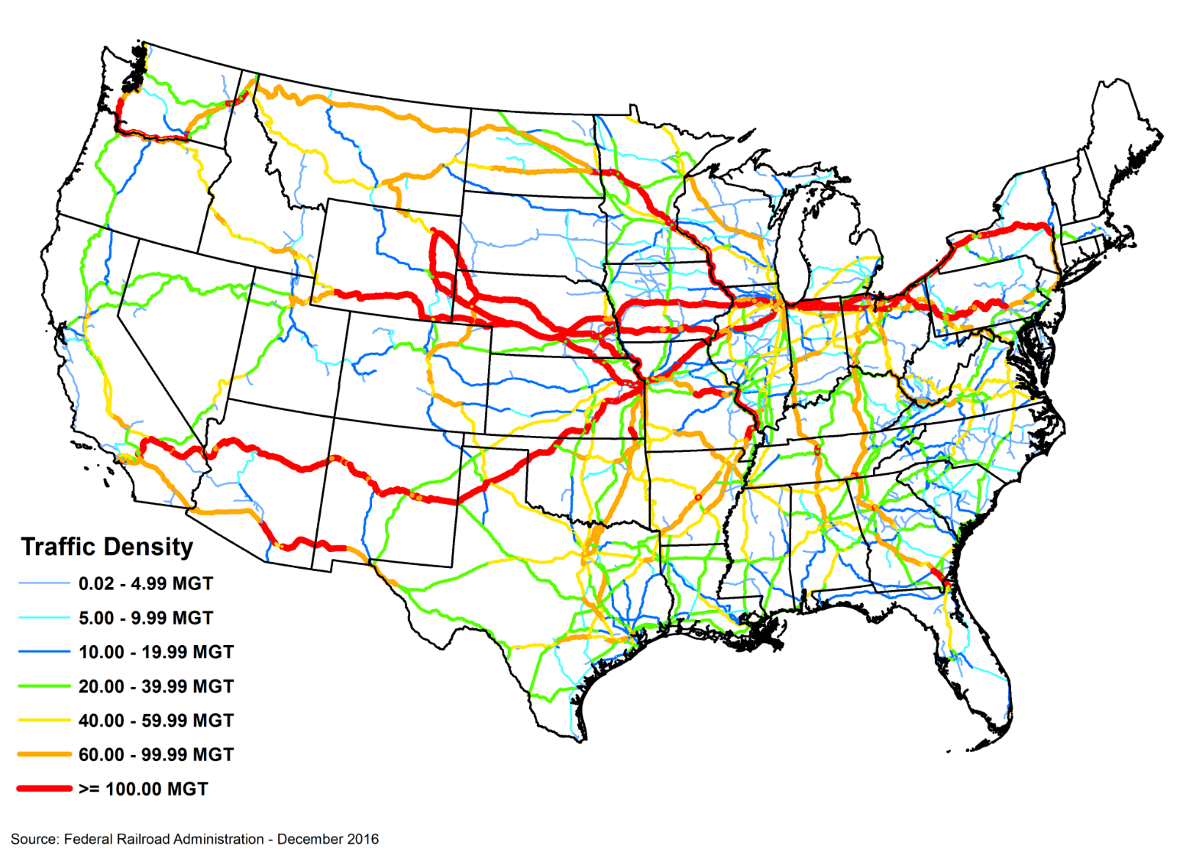
Rail Workgroup: Line Haul
~85% of rail emissions
Will use a proprietary Federal Rail Administration (FRA) database of link level activity.
Attempting to get company specific fleet technology and modern
emissions rates.
Use ARC/INFO and
Access to do spatial
processing and
emissions calcs.

Slide 39
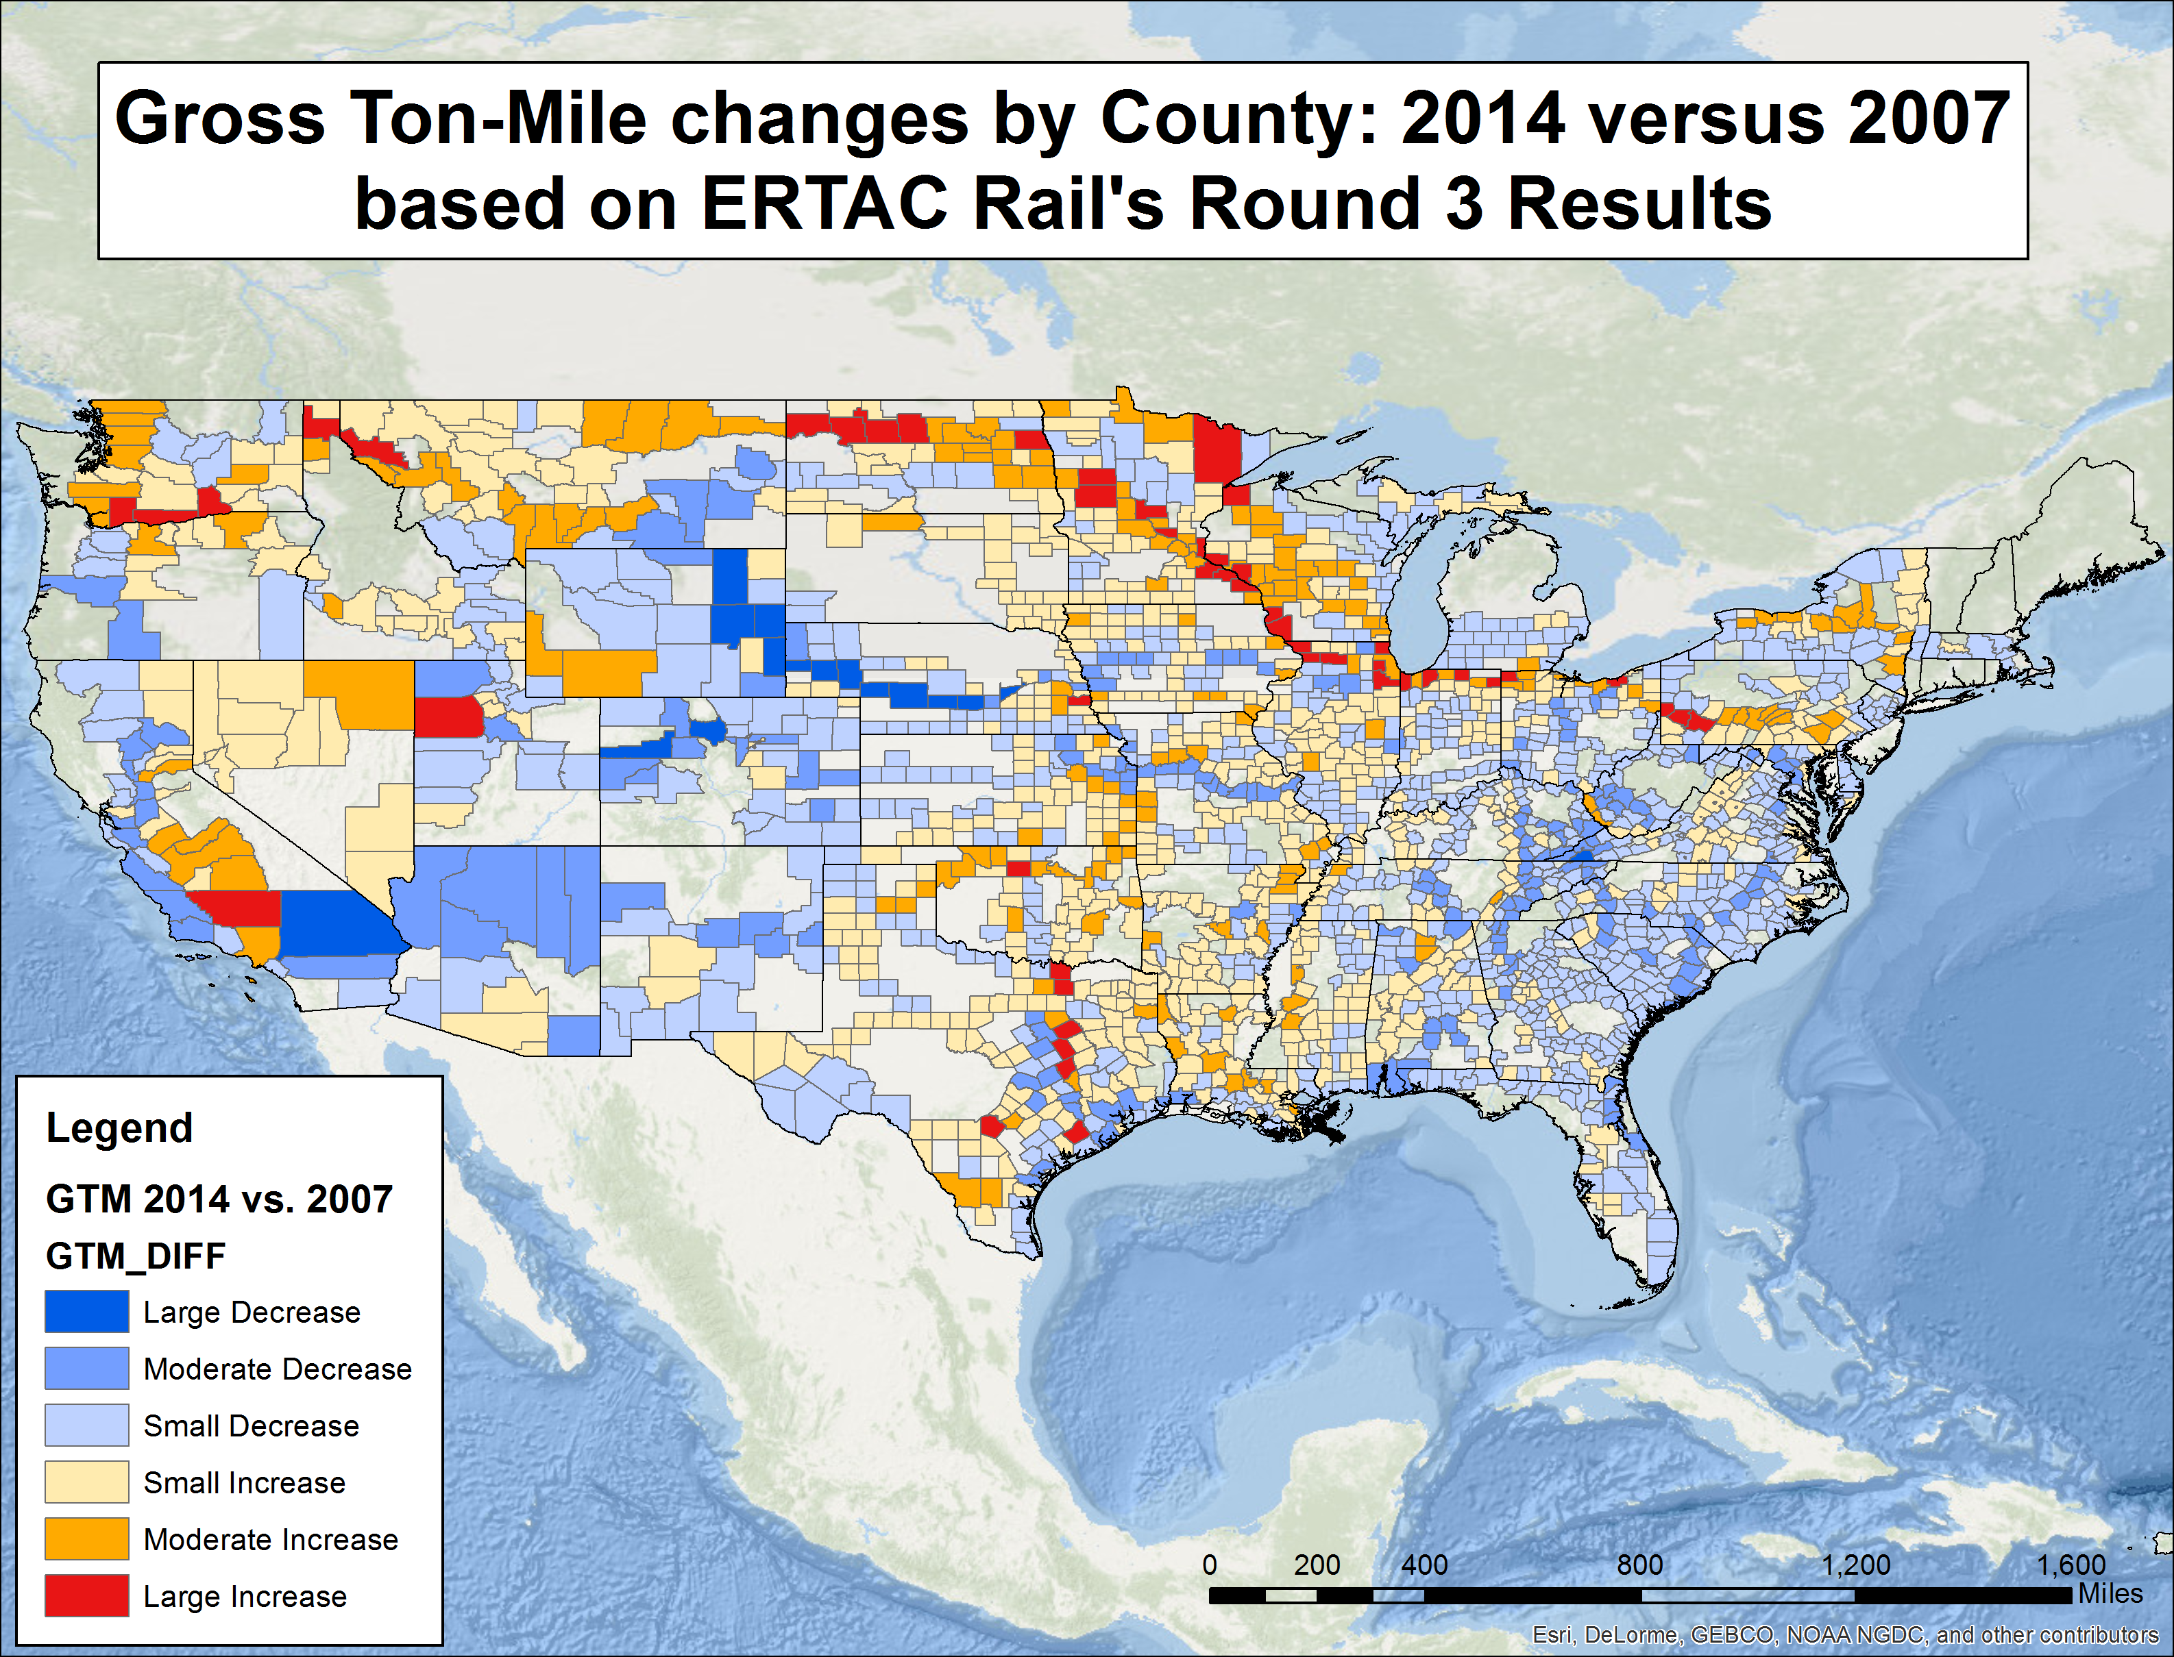

Slide 40
Rail Workgroup: Other Categories
Yards: Based off historical inventories, With updated fleet information. Data improvement request going to companies to tell us yard activity.
Class 2/3: 3% of rail emissions from small railroads, might be higher in some states. May be asking states to collect company specific fuel use.
Commuter: New category, not in past inventories. Need to collect fuel use and engine technology. There will be pathways to give link specific and temporal information. Initial calculations indicate passenger rail may emit as much as line haul in some cities.

Slide 41
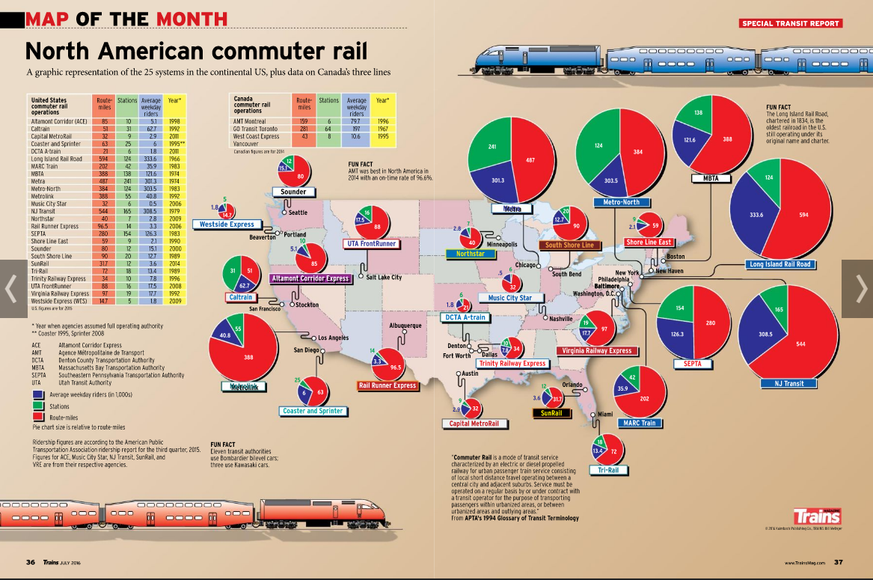

Slide 42
Rail Workgroup: Timing
Plans are to include 2016 estimates for all 4 groups in the beta inventory.
Will seek outside comments in May/June
  Yard activity/fleet mix for genset/critical yards
  Class 2/3 and passenger fuel use
  Passenger fleet mix, link level activity, and temporal information.

Slide 43
Commercial Marine Workgroup
Co-leads: Mark Janssen (LADCO), Michael Aldridge (IL EPA)
Schedule: Calls on 4th Tuesday at 2:00pm Eastern
Members:
  23 Total: 14 state/local/regional, 3 DOT, 6 EPA

Slide 44
Commercial Marine: First Steps
Will likely break into geography and emissions subgroups
Difficult getting everyone up to speed because it’s not clear what is the best practice for this category
Longer timeframe given challenges of this sector
EPA is building a CMV emissions tool, but still 2-3 years away
National data likely not out until 2016v1.0 inventory

Slide 45
Commercial Marine: Approach
Use AIS data of individual ship movements
Identify operating modes: Underway, Hoteling, Maneuvering
Calculate fuel use and power requirements
Calculate emissions
Challenges:
  Identify ports and waterways so that problematic data can be removed
  How to follow rivers and stay in lakes/ocean
  What to do with long (months) between pings
  Where to get ship level information
  Who will write calculation and GIS code?
  How to remove pleasure craft

Slide 46
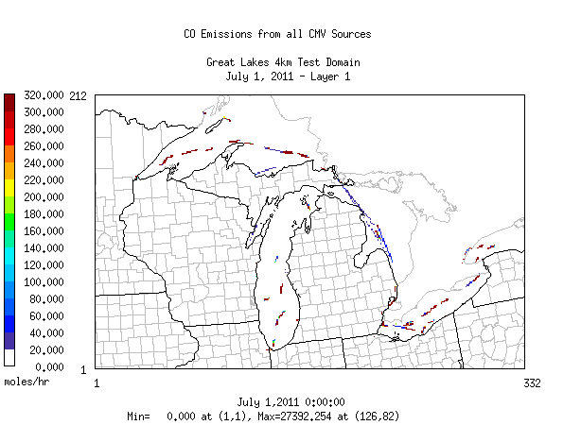

Slide 47
How Important are Rail & Marine?

Slide 48
Fire Workgroup
Co-leads: Jeff Vukovich (EPA), Tom Moore (WESTAR and WRAP)
Schedule:
  One kickoff call thus far; next call April 5th at 1:00pm Eastern
Members:
  AK, AL, CA, CO, GA, ID, KS, MT, NC, NJ, NM, NV, NY, TX, UT, WA, WY, EPA, WRAP, Nez Perce Tribe
  USFS, NPS, and one contractor are also participating
  Some members experienced in using fire emissions model framework (SMARTFIRE and BlueSky) and performing comparisons

Slide 49
Fire Workgroup: First Steps
Alpha version: draft 2016 inventory from SMARTFIRE2 and BlueSky v3.5; HMS detects, ICS-209, and GEOMAC input data; Canada and Mexico estimated from FINN
Members requested to review the inventory and technical memo for the alpha version
Compiling list of QA steps to perform
Examining the temporal profiles, speciation profiles and possibly plume rise algorithm
Hope to get USFS cooperation in gaining access to updated Bluesky modules (version 4)
Group will review any S/L/T data that are available
Likely to focus on large fires
Investigate better fire detect dataset
Some interest in pile burns and international fires

Slide 50
Fire Workgroup: Next Steps
Approach for Beta version and other high level plans
Dependent on resources
Could include another SMARTFIRE/Bluesky simulation(s) with improved input data
Technical documentation
  QA products generated by workgroup
    Reports/Maps
    Comparisons
    Model parameters/setup
Workgroup will be interested in AQ modeling applications that use the Alpha and Beta versions of the fire inventories

Slide 51
Biogenic Workgroup
Co-leads: Doug Boyer (TCEQ), Jeff Vukovich (EPA)
Schedule:
  Two calls thus far; next call March 20th at 2:00pm Eastern
Members:
  TX, CA, AL, GA, AZ, MT, WRAP
  Some members experienced in using biogenic emissions models and performing comparisons
Planning:
  A full evaluation of biogenic emissions does require air quality modeling and evaluation vs. AQ monitor/observational data

Slide 52
Biogenic Workgroup: First Steps
Alpha Version: EPA generated annual emissions with BEIS3.61
TCEQ also generated annual emissions with MEGANv3
Group selecting time periods in 2016 to perform comparisons
Group compiling list of QA steps to perform on biogenic emissions datasets
Group considering generating a MEGANv2.1 dataset for comparison
May get an updated MEGANv3 in the coming months

Slide 53
Biogenic Workgroup: Next Steps
BEIS3 and MEGANv3 datasets will likely both be available as part of the 2016 collaborative platform
Technical documentation
  QA products generated by workgroup
    Reports/Maps
    Comparisons
    Model setup
Workgroup will be interested in AQ modeling applications that use the Alpha and Beta versions of the biogenic emissions datasets

Slide 54
Inventory Collaborative Next Steps
Workgroups will be prioritizing their work to produce beta version of the 2016 inventory by mid-summer; projections to 2023 and 2028 by late summer
Quarterly outreach calls by the Collaborative to report out on progress
Next outreach call: June 20 at 1:00 Eastern

Slide 55
Inventory Collaborative Wiki
These slides, answers to the questions posed during this webinar, live workgroup wikis, documentation, calendar:
http://views.cira.colostate.edu/wiki/wiki/9187

